Slide 1
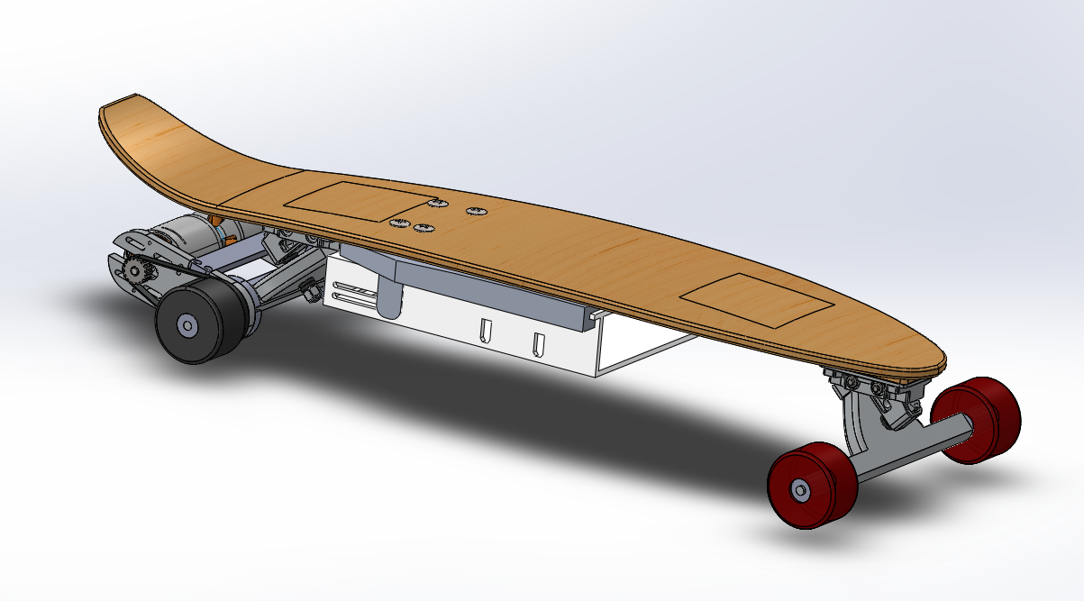
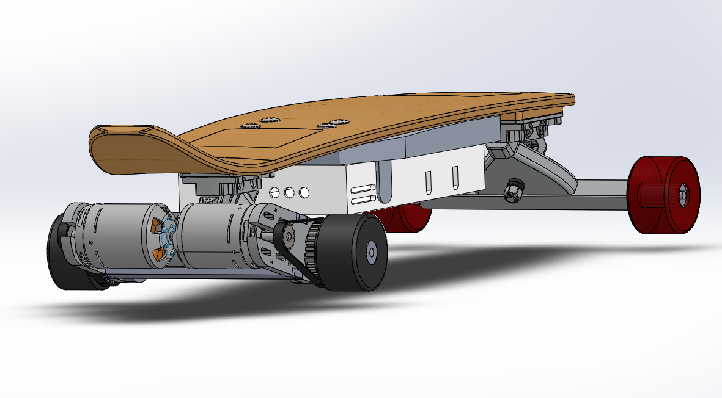
L2AHTB1: Electric Skateboard
P.M. Toby Ashton, Jacob Black, Haydn Lisk, Hugo McCartney, Edward Street, Sam Sutcliffe

Slide 2
Introduction
Retrofit for wide range of available boards
Commuting and recreation
Predicted Load: 120kg
High performance
Maximum Range: 15km
Top Speed: 15m/s on flat, 8m/s on max gradient
Weight: 8kg
Notes:
The aim of this project is to retro fit this long board to meet criteria listed in the project brief. This involves a typical commute in a hilly city. we ensured that the product is more than capable of not only being suitable for this case, but also for any other commuters, and even for skateboarding hobbyists for recreational use. The maximum speeds are more than sufficient to justify powering it, but are also easily controlled as to allow the user to travel at speeds they feel comfortable with.

Slide 3
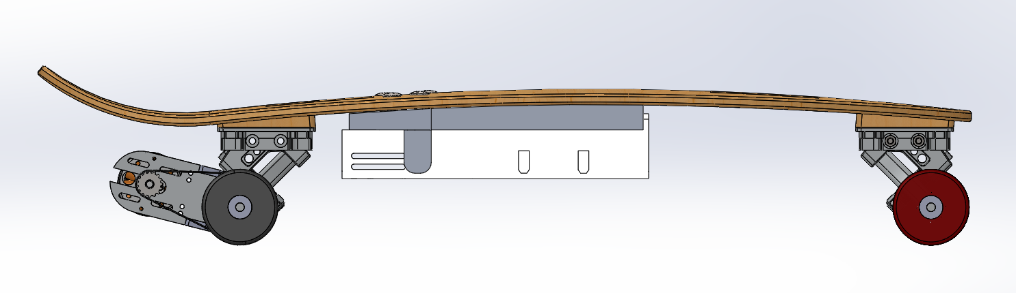
Board
Rear Trucks with integrated motor and drivetrain
Electrical components casing
Symmetrical front trucks
Notes:
This image shows sideview of a model for the product assembly
The product includes Redesigned rear trucks with two integrated motors independently driving both rear wheels
Similarly, Symmetric set of standard trucks designed for the front
Finally, Casing will be designed to contain electrical components such as battery and electronic control devices

Slide 4
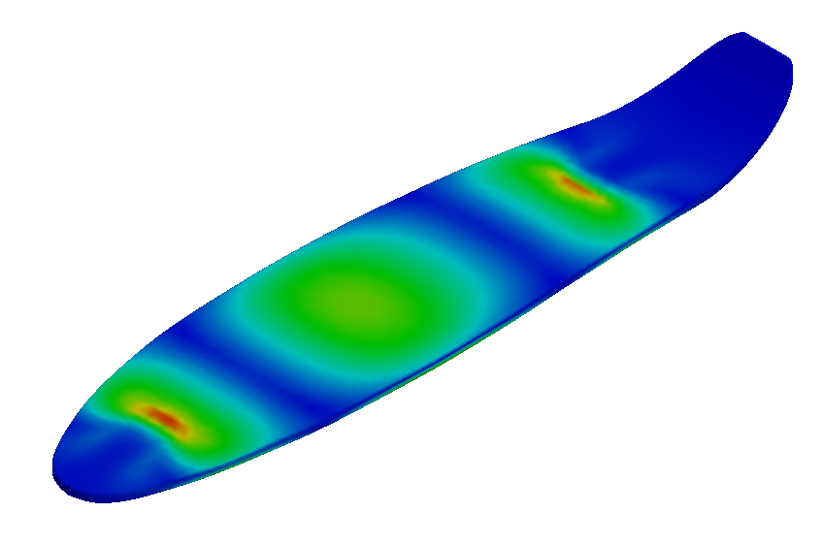
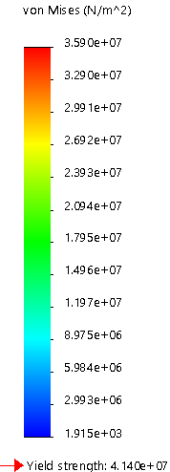
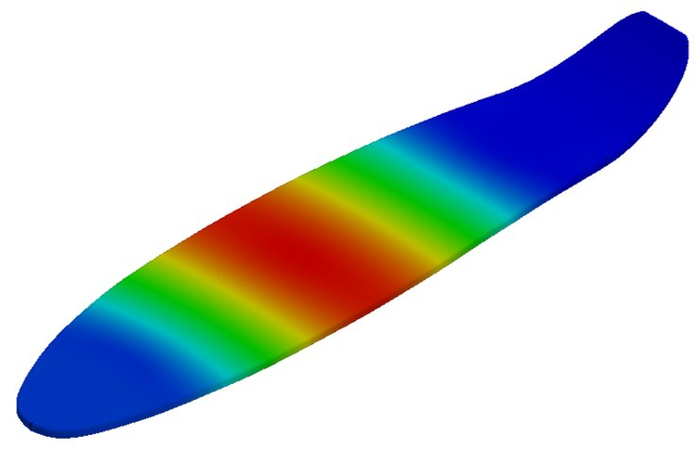
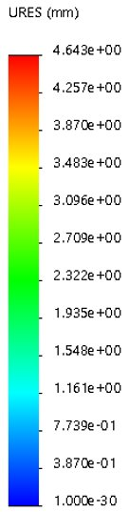
Board Analysis
Stress Analysis
FEM analysis
120kg user load concentrated at centre
Approx. 4.5kg components
High stress at truck fixtures and center of board
35.9MPa maximum compressive stress
Does not exceed compressive yield stress
Displacement Analysis
4.6mm maximum deflection
Notes:
A F-E-M analysis was done on a CAD model of the provided skateboard using SOLIDWORKS, considering a maximum user load of 120kg concentrated at the centre of the board, and an approximated 4.5kg of electrical components and casing attatched to the bottom of the board at an appropriate location as indicated in the previous image.
Compressive yield stress: 41.4MPa

Slide 5
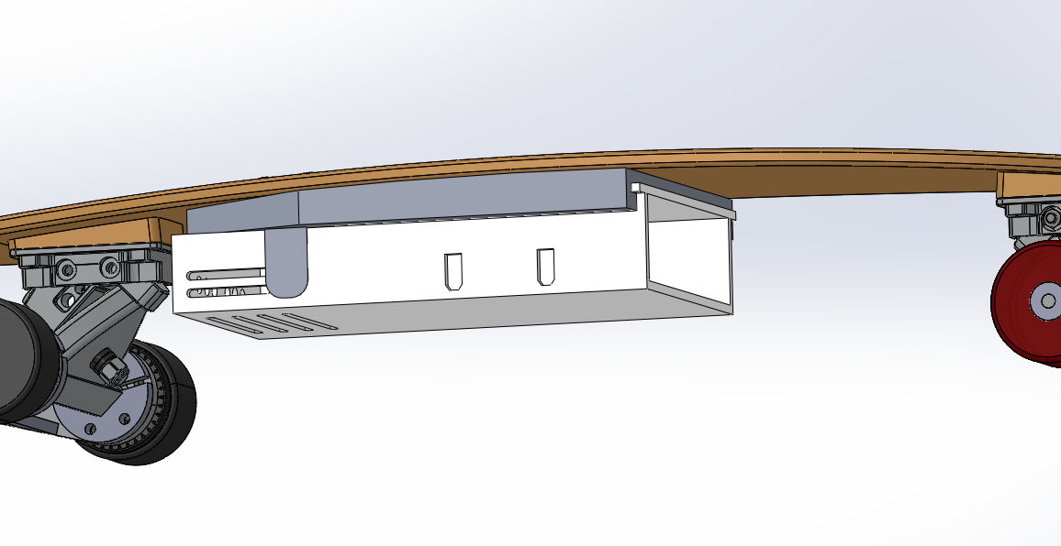
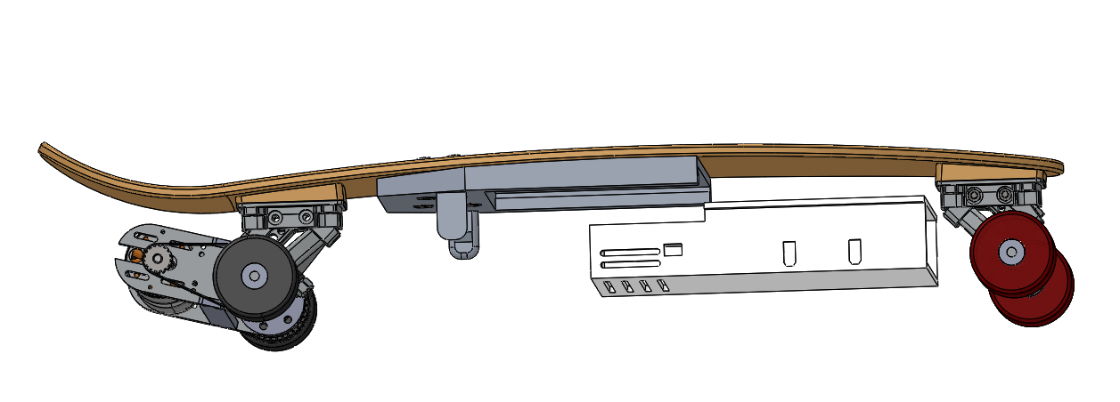
Electronic Components
Quick-release clamps
Fixed railing
Detached
Attached
Notes:
In order to attatch the electronic components to the board, a railing and quick-release system was adopted for compatibility for all common skateboards/longboards, without the need to redisign the battery box for each skateboard. The railing can be fixed onto the bottom surface of a board with screws, allowing for an easy setup. The displayed images show the railing and quick-release mechanism of a battery box

Slide 6
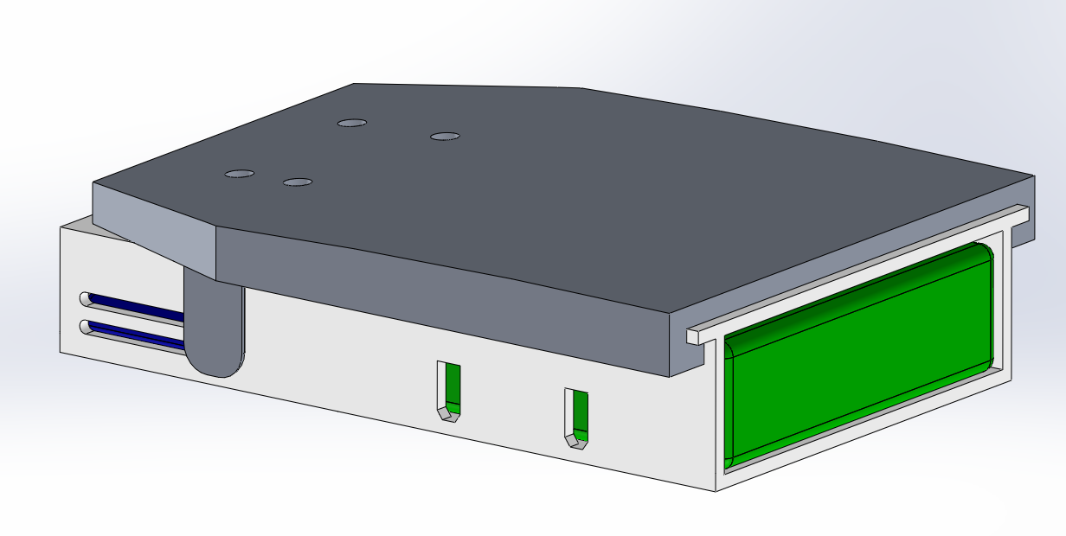
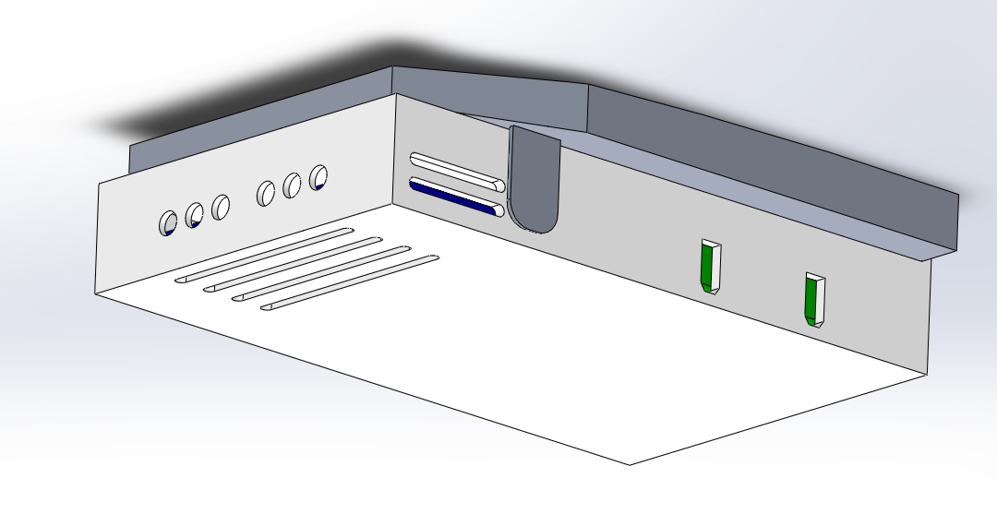
Battery Box
Motor connections
Charging Port
Control Electronics:
ESC, Microcontroller
Batteries
Ventilation
Slots
Notes:
The following images show an exerpt of the battery box mounted to the railing, with the frontal wall of the box removed for clarification. Two battery blocks will be placed at the front of the box, and the control electronics such as the electronic speed controller (ESC) and the microcontroller will be placed at the back. The box will include cutouts for charging ports, outlets for connecting the controller chips to the motor, and ventilation slots as the ESC as a heat sink as they would experience significant heat under high operation voltages

Slide 7
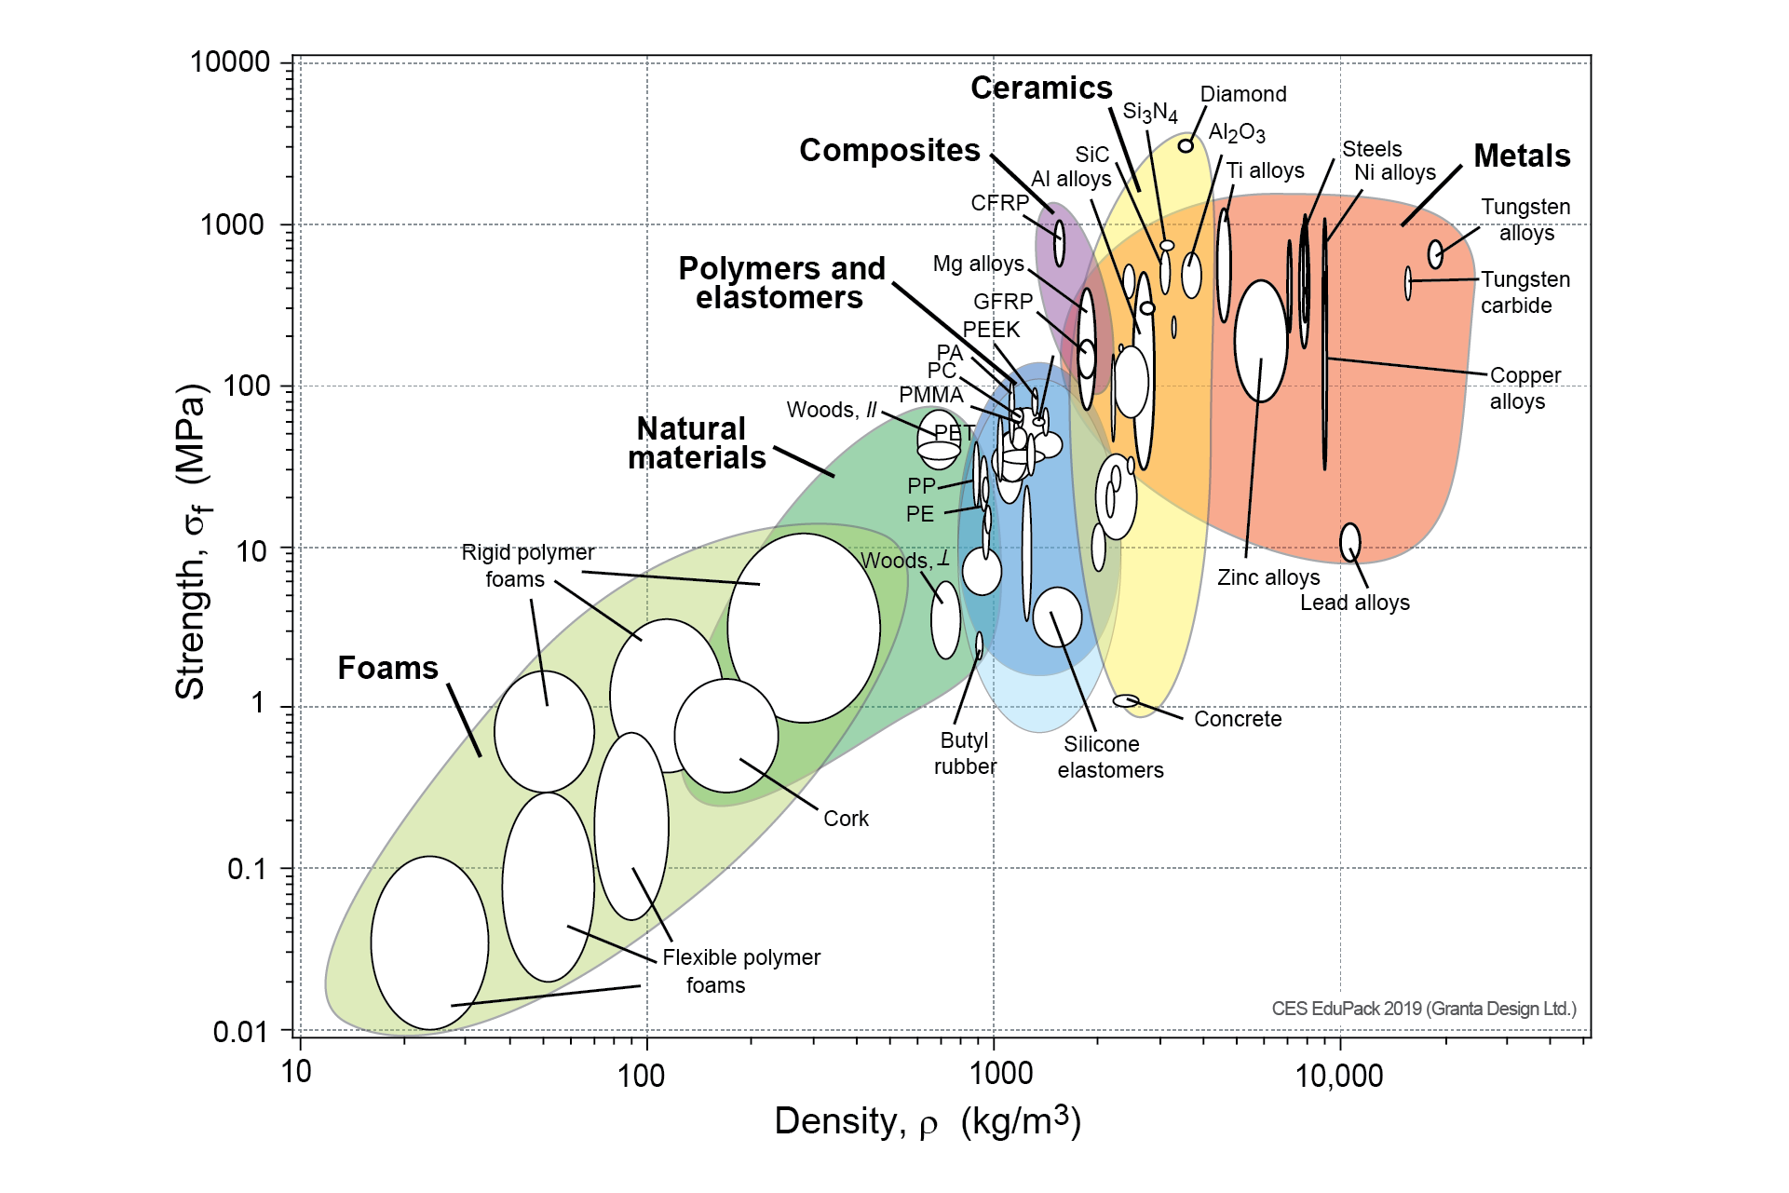
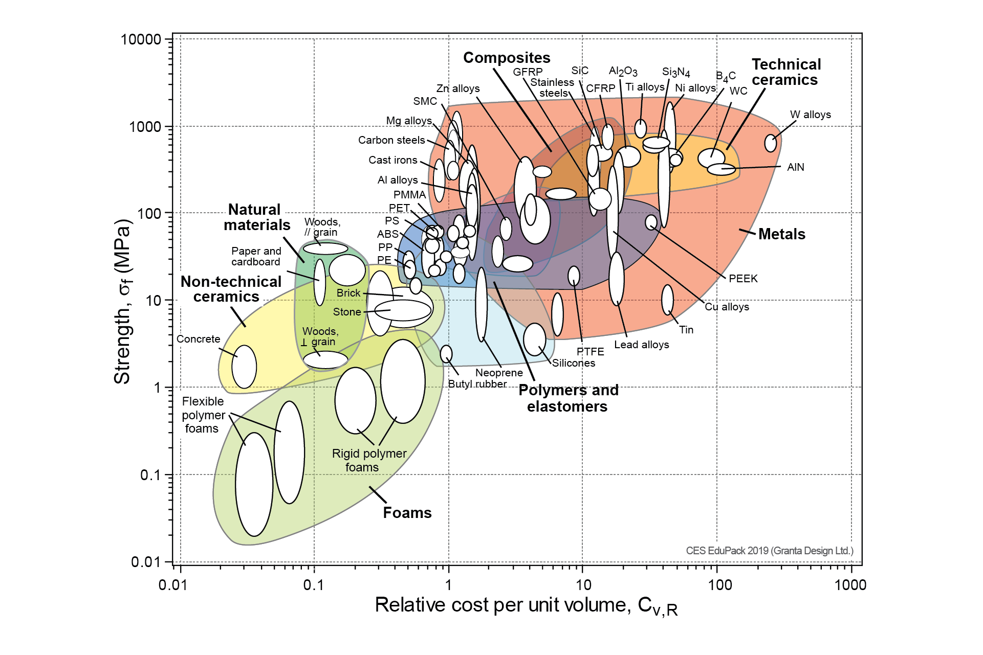
Material Selection
Chart created using CES EduPack 2018, Granta Design Ltd.
Notes:
A suitable material for the battery box and railing was decided using an Ashby plot, which compare material properties such as density and strength for a broad range of commonly used manufacturing materials. From this, it was decided that ABS plastic will be a suitable material for this implementation. Commonly used for Keyboards, power tool housing, LEGO bricks. ABS lies on the plots as shown
1020kg/m3, exponentially lighter than metals
ultimate tensile strength 49MPa ,
can be see to be Relatively cheap in comparison to other polymers and metals
Thermoplastic – softens into a viscoelastic form at what is called a glass transition temperature – 105 degrees
Rigid when hard: Youngs modulus: 2.65GPa, ductile when soft
Amorphous polymer: random polymer structure
ABS (Acrylonitrile-Butadiene-Styrene) Acrylonitrile: heat resistance and stability, Butadiene: impact strength and toughness, Styrene: formability and ductility
Youngs modulus: 2.65GPa
Resistance to chemical corrosion
PLA (polylactic acid): Smoother surface finish, however lower wear and heat resistance – 60
http://www.matweb.com/search/DataSheet.aspx?MatGUID=3a8afcddac864d4b8f58d40570d2e5aa
https://grantadesign.com/education/students/charts/?fbclid=IwAR3QTVDeu0buoZyua0FoEastn8uKTbQC7B0_s532JQ2qrBNAvo-ouW9IjG0
http://injectionmoldingonline.com/Molding101/Polymers.aspx
https://www.creativemechanisms.com/blog/everything-you-need-to-know-about-abs-plastic
Image: http://www.retlawindustries.com/Info/ABSPlastic

Slide 8
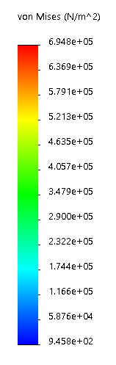
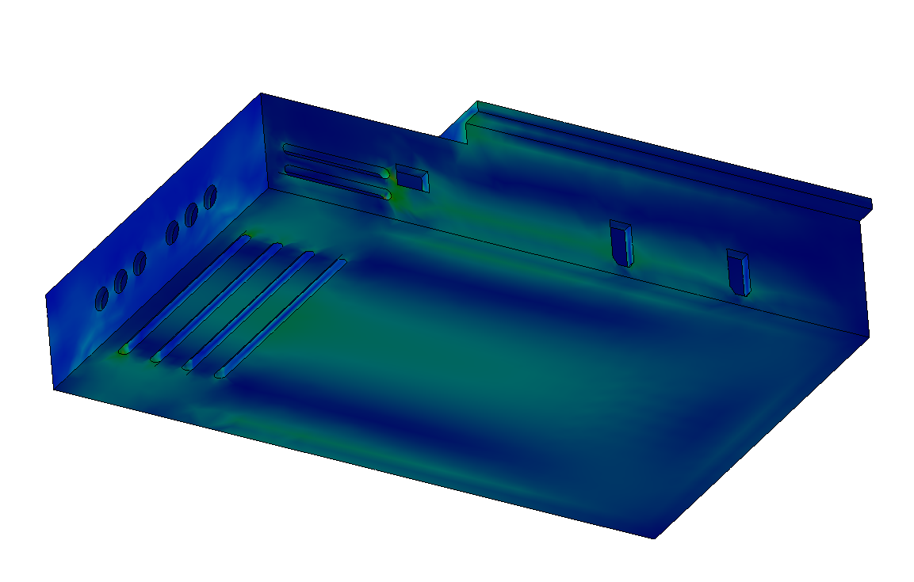
Battery Box
Stress Analysis
Mounted on railing with electronic components
Stress concentrations at ventilation slits
0.695MPa maximum tensile stress
Notes:
49MPa ultimate tensile strength

Slide 9
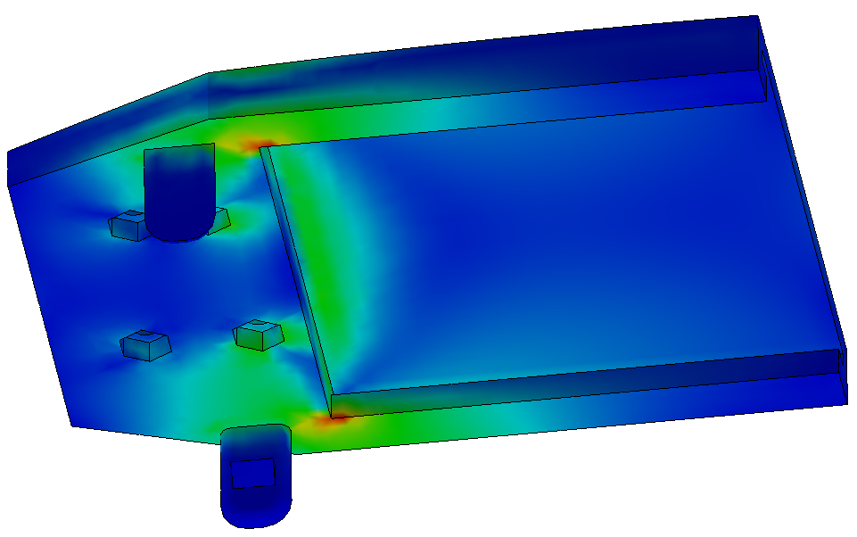
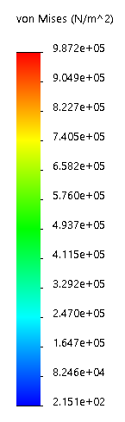
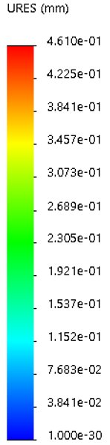
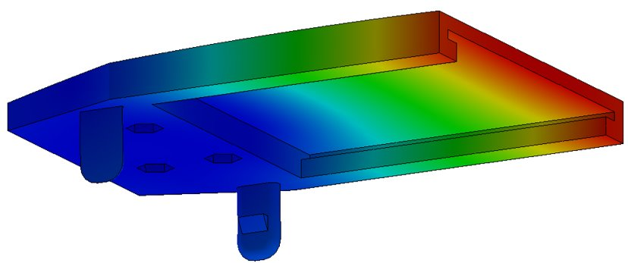
Railing
Stress Analysis
Attatched battery
Stress concentration at inner corners
0.987MPa maximum compressive stress
Displacement Analysis
Approx. 0.46mm maximum deflection
Total ground clearance = 6.5 cm when loaded
Notes:
49MPa ultimate tensile strength

Slide 10
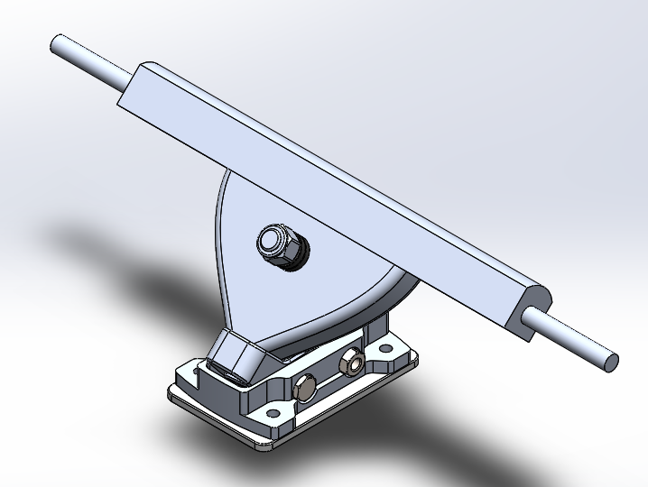
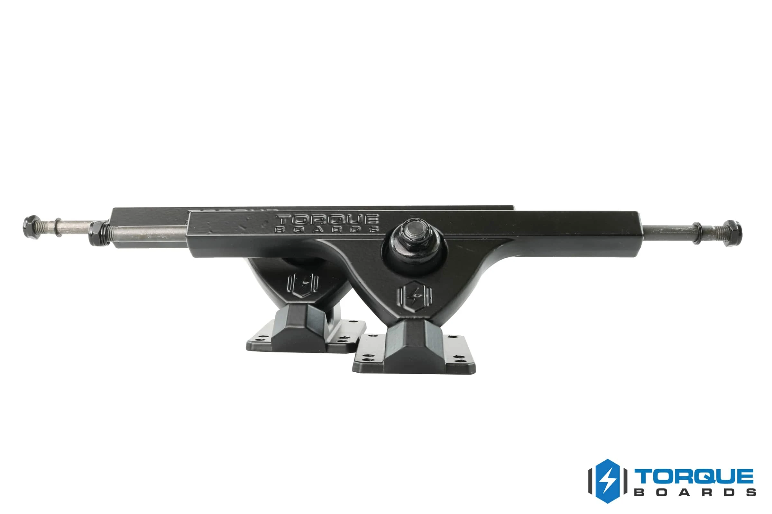
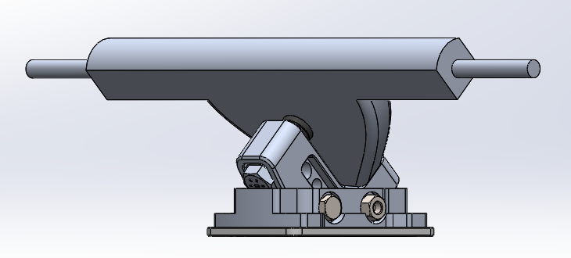
Trucks
218mm wide hanger
314mm including axles
Cast aluminium construction
New Longboard Trucks
Image from Torque Boards
Notes:
For the trucks, we are replacing the existing ones with another set from a company called torque motors.
Our CAD rendering of the truck is on the left, and a picture from the website is on the right.
The truck has the same baseplate dimensions and width as a standard longboard truck, like that already on the board. It is a cast aluminium construction so it is strong enough to hold the load, but lightweight enough to help with the portability.

Slide 11
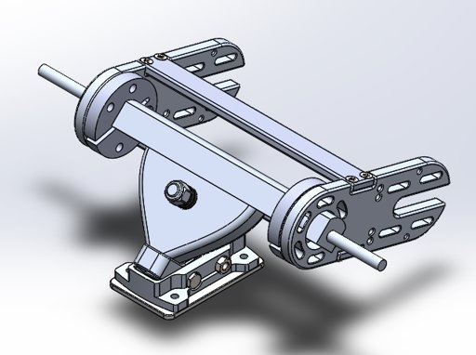
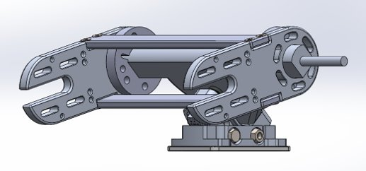
Motor Mount
Weight of both trucks and mount: 1.5kg
CNC milled Aluminium
Notes:
By using a design matrix it was determined that the ideal motor configuration is to have two rear motors, mounted on the same side of the truck
We will also be acquiring the motor mount from torque motors as well, as they have a sturdy mount design that meets our requirement for two 6374 motors mounted on the rear truck.

Slide 12
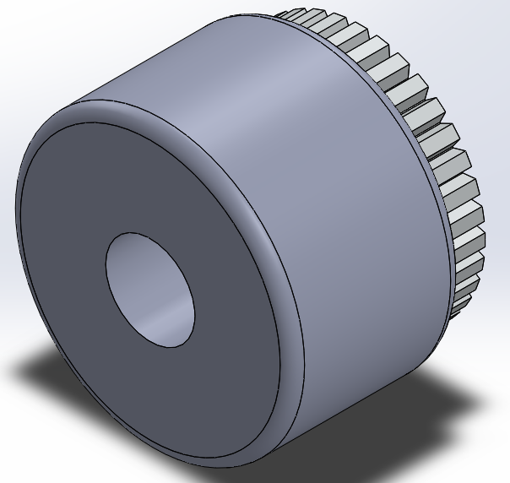
Wheels
Wheel Dimensions
Wheel Materials
Bearing Materials
Wheel-Gear Attachment
Notes:
The key points to cover are the wheel and bearing materials, as well as the attachment of the transmission gear to the driven wheels. However, a brief summary of the chosen dimensions is in order: longboard wheels normally vary between 60 and 100mm in diameter. As this is intended as a replacement design, it was decided that the original wheel diameter of 70mm would be maintained, with the drive and suspension systems designed to be compatible.

Slide 13
Wheel Materials
Material | μ-rolling | μ-static | Cost (£/wheel)
Polyurethane | 0.02-0.04 | 0.2 | 2.50-37.50
Rubber | 0.02-0.04 | 0.35-0.45 | 3.80
Conclusion | Both acceptable for non-driven | Rubber provides 75-125% in μ-static, better for driven wheel | Greater variation in polyurethane, customer's preference
Notes:
Typical construction consists of a hardened plastic core with outer layers of polyurethane. This material provides an acceptably small rolling resistance making them suitable for use as the non-driven wheels. However, rubber achieves a significantly higher static coefficient, making rubber the better option for the driven wheels. For the non-driven wheels, we decided to stick with polyurethane as rubber offers no significant improvement in this area, allowing the user to determine the quality of skateboard wheel they wish to pay for.
If asked: Styrene-butadiene rubber most appropriate rubber compound due to its resistance to wear and friction (used in tyres).

Slide 14
Bearing Materials
Material | σ_{UTS} (MPa) | Brinell Hardness (kg/mm²) | Specific Heat Capacity (kJ/kgK) | Approximate Cost (£)
Steel: SAE-AISI 52100 | 590-2100 | 180-210 | 0.475 | 15
Titanium: ASTM Grades 7 | 550 | 200 | 0.554 | 25
Ceramic: Silicon Nitride | 170 | 1479 (converted from Vickers’ hardness) | 0.673 | 70-115
Notes:
Three materials are widely used in skateboard bearings: steel, titanium and ceramic. Whilst it can be difficult to establish exact figures for energy loss/rolling resistance, comparisons can be extracted from their material properties: ceramics typically have a much greater Brinell Hardness than steel and titanium , indicating greater efficiency as less energy will be lost in deformation of the bearing balls. However, ceramics also have a lesser yield strength than those of its metal rivals and are also prohibitively expensive, making them unsuited to this user case. As can be seen, titanium and steel bearings exhibit similar performances, which might indicate that steel be the superior option due to its lower cost. However, titanium bearings exhibit great heat resistance, enabling better performance at higher speeds. Additionally, titanium provides greater long-term resistance to wear and corrosion, allowing for the durability required by the user and making such bearings the ideal choice.

Slide 15
Wheel -Gear Adhesives
Estimated Minimum Tensile Strength Required σ ~ 0.15N/mm^2
Adhesive | Tensile Strength (N/mm²) | FOS | Cost (£/mm²) | Cost (£/per wheel)
Weicon GMK 2410 Rubber Metal Contact Adhesive | 0.54 | 3.6 | 3.72x10^-5 | 0.0954
Cole-Parmer Silicone Rubber Bonding Cement: DOWSIL™ 732 Multi-Purpose Sealant | 2.3 | 15.3 | 4.101x10^-5 | 0.1052
Loctite Super Glue ULTRA Gel Control | 21.12 | 140.8 | 4.869x10^-4 | 1.249
Notes:
The transmission system requires an attachment of a gear directly to the wheel for the transfer of drive. Originally a combination of chemical and mechanical fastenings was considered, such as screws/bolts combined with an adhesive. However, upon researching some of the market leaders in rubber-metal adhesives, it was determined that the performance of these glues was sufficient to render the inclusion of mechanical fastenings unnecessary, as all of these adhesives satisfy this requirement with wide FOS margins, allowing for cost to become the limiting factor.

Slide 16
Drive System Configuration
Category | Weighting (/5) | FWD Belt | FWD (2x Hub) | RWD Belt | RWD (2x Hub) | AWD Belt | AWD (4x Hub)
Weight Distribution | 3 | 1 | 1 | 4 | 4 | 3 | 3
Handling | 3 | 3 | 3 | 3 | 3 | 4 | 4
Cost | 3 | 4 | 2 | 4 | 2 | 3 | 1
Manufacturability | 4 | 4 | 3 | 4 | 3 | 2 | 2
Safety | 4 | 4 | 4 | 4 | 4 | 5 | 5
Control Complexity | 4 | 4 | 2 | 4 | 2 | 3 | 2
Transmission Efficiency | 4 | 3 | 4 | 3 | 4 | 2 | 5
Total |  | 84 | 70 | 93 | 79 | 78 | 80
Notes:
Drive system configuration > front/ rear or ALL WHEEL> matrix > rear > weight distribution > riders forward momentum > braking. Without unnecessary cost of an all wheel drive system
This leads us onto the drive system configuration where the main decision is if front rear or all wheel drive should be used, as can be seen from the matrix, it was decided to use a rear wheel drive was selected due to the superior weight distribution so that the weight of the motors counteracts slightly the forward momentum of the rider particularly when decelerating. {Also there is more space at the rear of the board} Without unnecessary cost of an all wheel drive system
%This leads us onto the drive system - a major decision to be made here was the system configuration to be used. As can be seen from the matrix, a rear-wheel drive came out on top, with particular advantages in weight distribution. A rear weight distribution was favoured in order to counter-balance the rider's forward momentum during operation particularity during breaking. Without unnecessary cost of an all wheel drive system

Slide 17
Drivetrain Requirements
High Torque
High Speed
Efficient Power Transmission
Quiet
Compact
Affordable
Notes:
Drivetrain Needs torque and power hilly commute without compromising efficiency noise, size or price

Slide 18
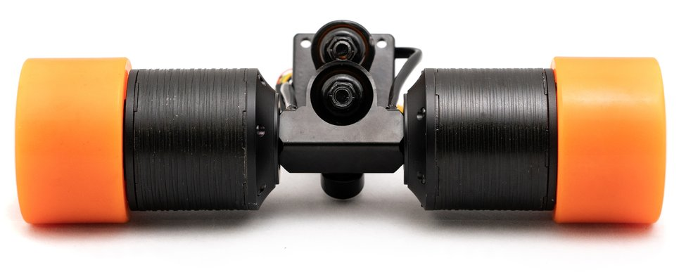
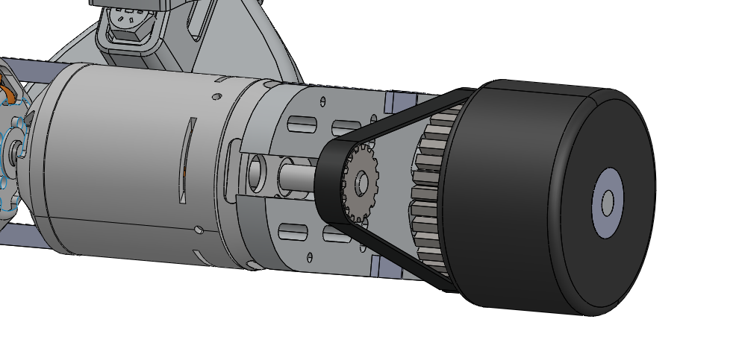
Drivetrain Types
Direct Attach Motor
Image from MBoards
Belt Drive System
Notes:
From these parameters the specific drivetrain can be considered
One option directly attaching Motor to wheels> allows for a compact system, quiet + efficient power transfer > limited space > motors cant deliver required torque + power > furthermore no gear ratios + replacement {variation, hub, heat}
So a Belt/chain: power from motor > transferred > cog directly attached to the wheel >> more space > larger motor > more power. Also enables easier replacement.
Chain> higher torque, extra torque unnecessary > belt >light quiet >chosen overall
From these parameters the specific drivetrain can be considered.
One option considered was to use motors directly attached to the wheels, which allows for a compact system with quiet and efficient power transfer, however due to the limited space the motors can't be large enough to deliver the required torque and power and there can be no gearing. {a slight variation on this would be to use a hub motor built into the wheels which provides an even sleeker aesthetic but is more restricted in space and may suffer from overheating due to being surrounded by rubber.}
So a belt or chain arrangement could be used where the power from the motor is transferred to a cog attached directly to the wheel which gives more torque at the wheels than is supplied from the motor. This also allows for the relatively easy replacement of motors, belts or gears allowing for much easier maintenance than other methods. Also, this option is very efficient.
Between using a belt or a chain for this a chain could handle much larger forces but for this application this is unnecessary, so due to a belt being much lighter and quieter this was chosen overall

Slide 19
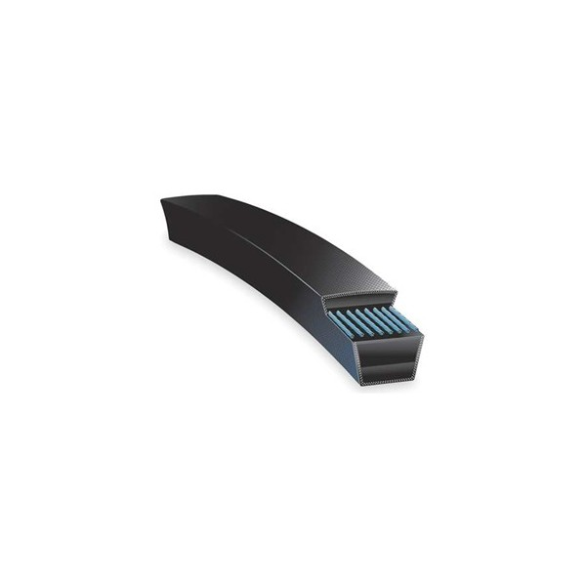
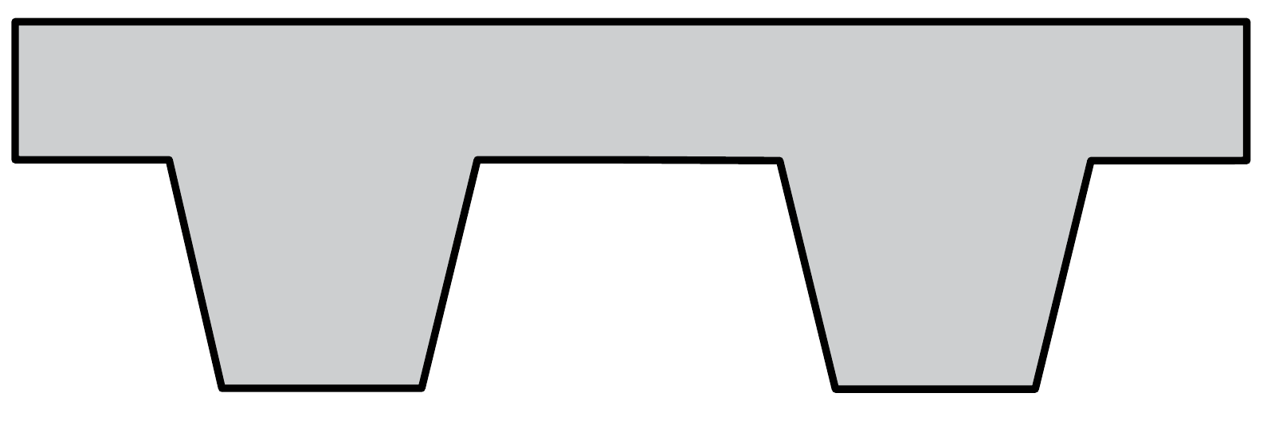
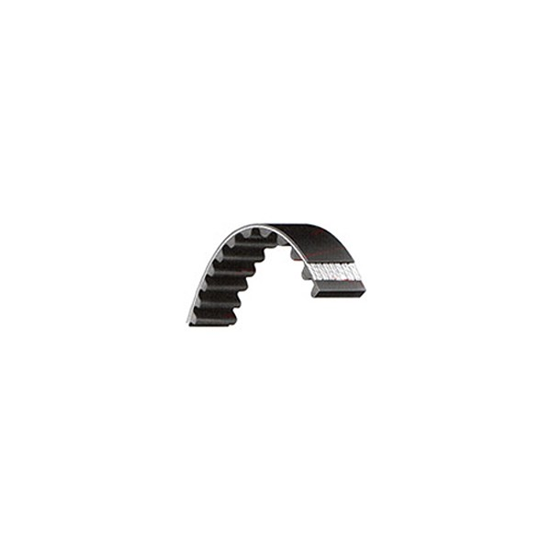
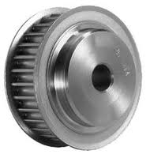
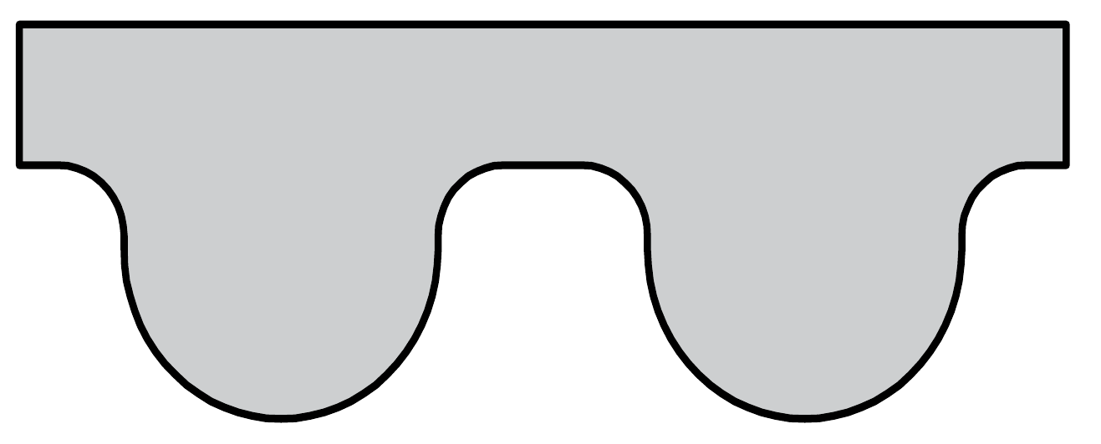
Types of Belt
Conventional Timing Belt
Image from Megadyne
V- Belt
Image from gpr industrial
High Torque Belt
Image from Megadyne
High Torque
Motor/ Wheel Pulley
Image from belting online
Toothed- Timing Belt
Image from gpr industrial
Notes:
The choice between belts was .. toothed rather than V slip @ high Torques increases efficiency speed of wheels from speed of motor > 2 wheels can be synced.
More specifically, HTB > greater power and torque transmission vs convectional
Main material concerns are to choose material withstand UV light, > and also have sufficient tensile strength > embedded glass fiber rods into the belts. The pulleys will have flanges so the belt can't slip..
The choice between belts was to use a toothed belt rater than a V belt to eliminate any slip at high torques which not only increases the efficiency but also means that the speed of the wheels can be determined from the speed of the motor which allows for two wheels to be synced.
More specifically a high torque belt would be used for much better power transmission vs a conventional belt.
The main material concern is that the belt has to be able to withstand UV light. Also the strength of the belt need to be sufficient which is achieved by having embedded glass fiber rods.
Finally the motor pully will have flanges so that the belt cannot slip of the motor or wheel.

Slide 20
Motor
AC Induction | Efficient Quiet Hard to control High torque at startup
DC Brushed | Easy Control Inefficient High Speed
DC Brushless | Easy Maintenance Long Lifespan Easy Control Efficient
Notes:
To deliver the required torque speed and power > derived from: diameter of the wheels and belt gear ratio. An appropriate motor must be chosen:
So decided DC rater than AC > partly Direct Current from batteries, much easier to control than induction.
Brushless rather than Brushed > longer lifespan and greater efficiency due to not having brushes.
LINK
To deliver the required torque speed and power. Using the parameters obtained from the diameter of the wheels and the belt gear ratio. An appropriate motor must be chosen. So it was decided to use a DC motor rather than an AC motor partly as the batteries provide Direct Current and as DC motors are typically easier to control. Specifically it was decided to use a brushless rather than a brushed motor due to the longer lifespans and greater efficiencies as a result of not having brushes. So over to Hayden who will talk to you about controlling these motors.

Slide 21
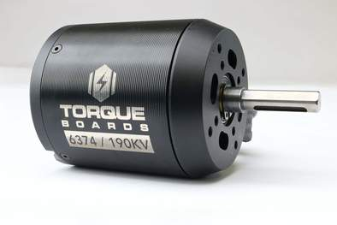
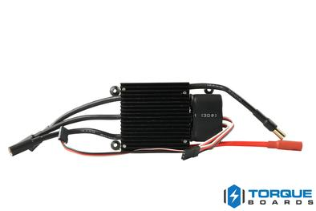
Drive Circuitry
Torque Boards 6374 190KV Motor:
Maximum Current: 80A
Maximum Voltage: 12s (A 12 cell LiPo)
Maximum Torque: 3.57 Nm
Integrated Hall Effect sensor.
Manufacturer Recommended ESC: 12S 120A Car ESC
Image from DIY Electric Skateboard.com
12S 120A Car ESC:
Continuous Current Rating: 120A
Burst Current Rating: 1080A (10 sec max)
Maximum Voltage: 12s
Forward and reverse capability
PWM Control
Image from DIY Electric Skateboard.com
Notes:
Now the motor is chosen, we need to select our drive circuitry to operate them.
This circuitry could be built ourselves, however due to the 50v operating voltages this is prohibitively dangerous and costly to design.
Systems are called electronic speed controllers, take dc and produce a 3 phase ac drive voltage.
12 cells is around 50v nominal, which is a high voltage risk, and therefore we will need to sufficiently isolate the high voltage terminals.
Therefore will use an off the shelf solution, choosing the recommended ESC characteristics by the motor manufacturer.
This ensures that the ESC will be suitable for the motor, and that it will be able to operate within a factor of safety of 1.5.
The speed is controlled by a PWM signal, with a refresh rate of 50 – 430Hz.

Slide 22
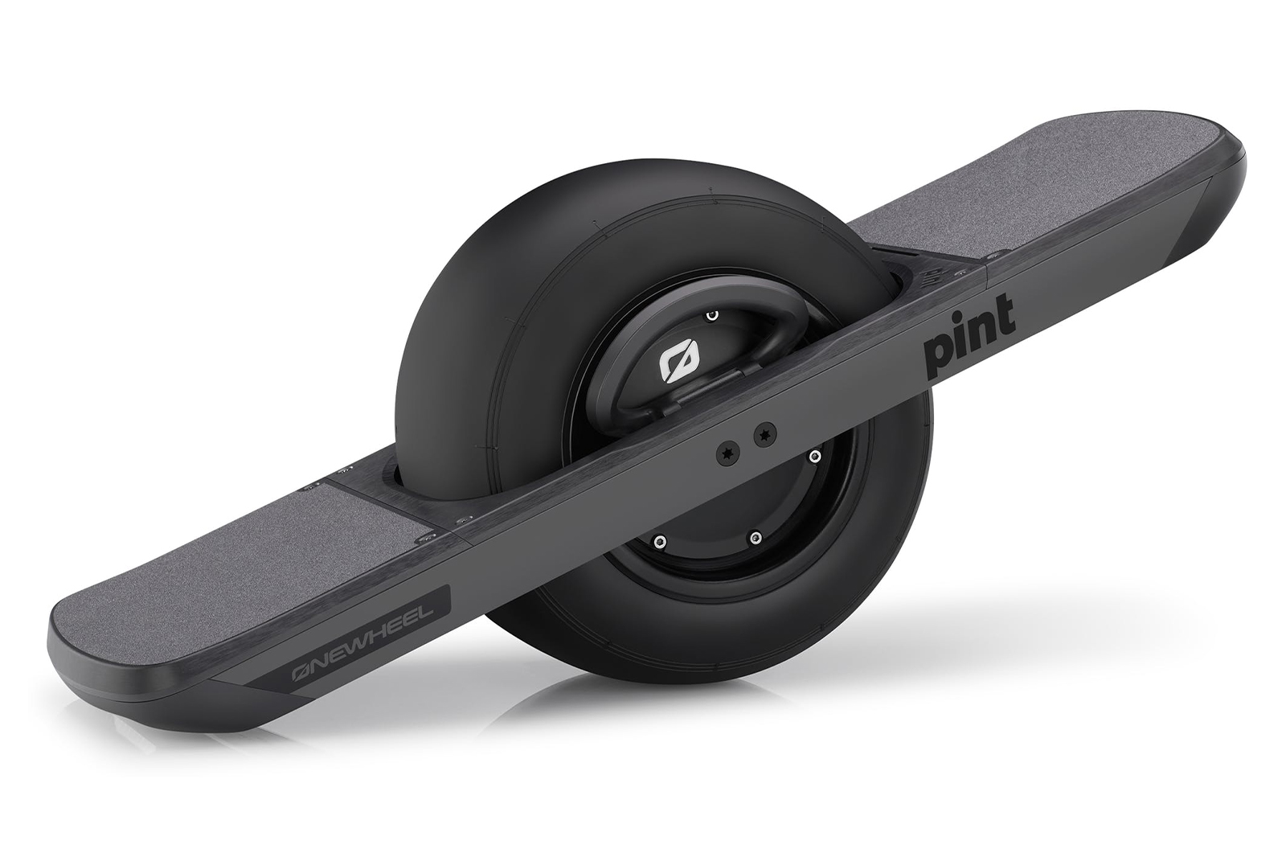
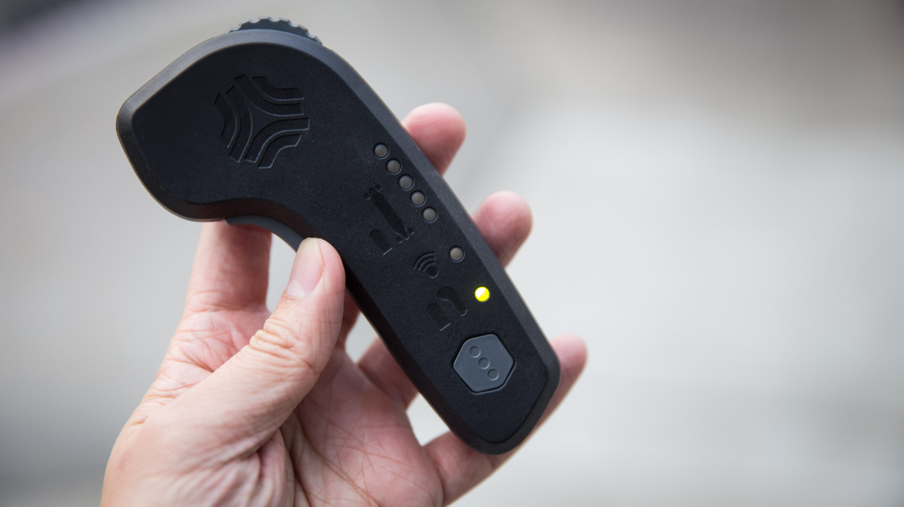
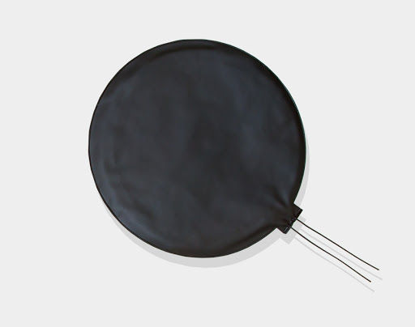
Pressure Pad Throttle Control
Already an existing technology, used on OneWheel
Measures the weight distribution of the rider
Lean forward accelerates, lean back decelerates
Less complex to develop than the handheld wireless remote used by Boosted
Can detect rider dismount (stop the board)
Image from Ride&Glide.com
Image from ArunElectronics
Image from Tested.com
Notes:
Pressure Pad control is an existing technology, used on one wheel, where a weight differential between the front and back pad maps to an acceleration.
The rider leans forwards to accelerate, and lean backwards to brake or decelerate or reverse.
This will have hard limits in each direction to prevent encouraging an off balance riding position.
Far less complicated to design and validate than the market leader boosted’s solution, a 2.4Ghz RF transmitter that is a handheld remote.
Get rider dismount detection for free, just measure when there is no weight applied to the pressure pads.

Slide 23
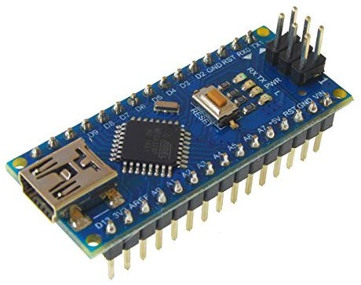
Microcontroller
Need a system to provide PWM signals to ESCs
Maps the throttle input to an acceleration of the motors
Power supply – regulated supply from battery
LCD monitor – debugging and status
Notes:
So we need a system that is going to link all these parts together, and by far the cheapest and quickest method to do this will be using an off the shelf microcontroller such as the Arduino nano pictured here.
They are often described as systems on a chip, and many of them natively support PWM signal generation.
They have analogue inputs, which can be used to record the voltage drop across the pressure pads to control the throttle.
There will also be an LCD screen connected to this microcontroller so that the rider can see the current speed, distance travelled and battery capacity remaining.
Power supply runs at 5v, which will be supplied by a regulator attached to the 50v battery supply.

Slide 24
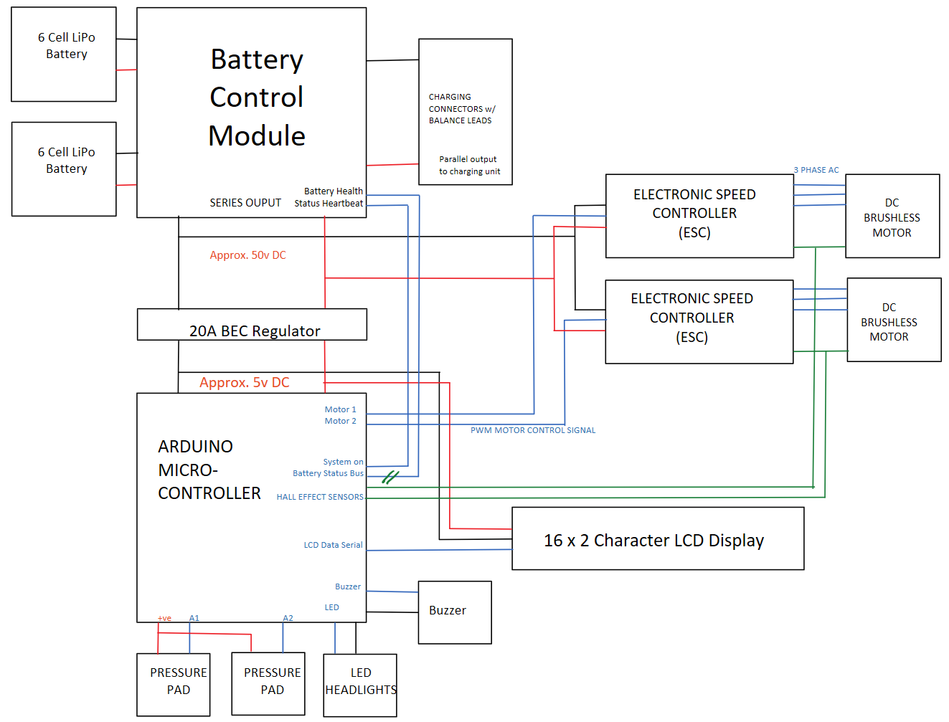
Block Diagram
50v Supply Rail
5v Rectified Supply Rail

Slide 25
Block Diagram
ESC and Motor Module:
2 Pairs
Controlled by PWM Signal
Hall Effect Sensors to measure rotation speed

Slide 26
Block Diagram
Regulator and Main Microcontroller
Runs at 5v
Uses a 20A regulator to step down from 50v
Many inputs and outputs to monitor the system
I/O components:
LCD to display battery capacity, speed etc
Buzzer to alert the rider
Headlights for riding at night
Pressure pads for throttle control

Slide 27
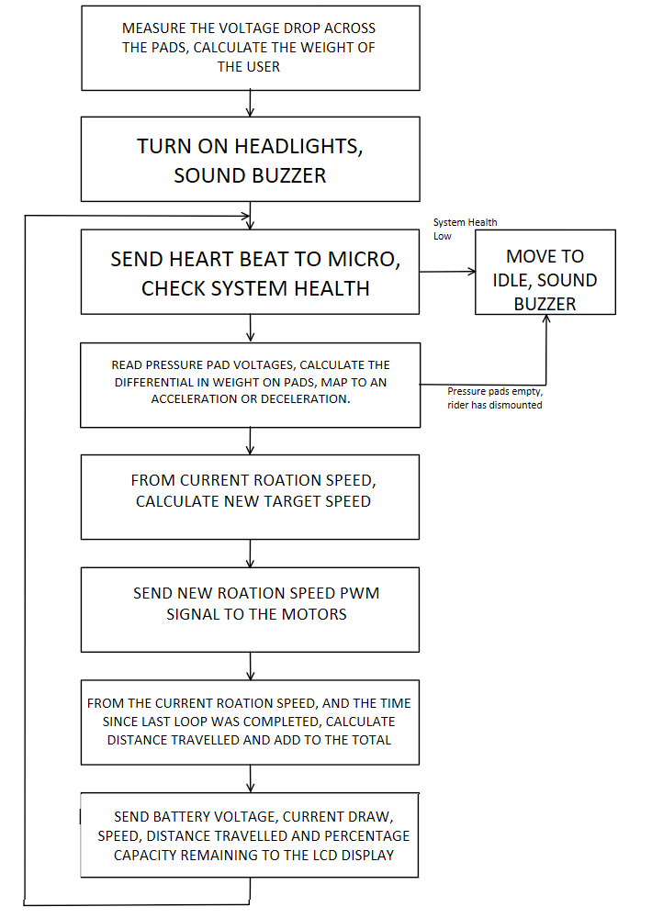
Calibration Stage
Main loops sends heartbeat periodically
Checks for system safety, stopping drive if it falls outside safe bounds
Reads pressure pads to find the acceleration
Sends signals to ESCs
Displays system status to user on LCD

Slide 28
Block Diagram
Battery Control Module:
Receives a heartbeat from Main Microcontroller
Reports back battery status to Main Microcontroller

Slide 29
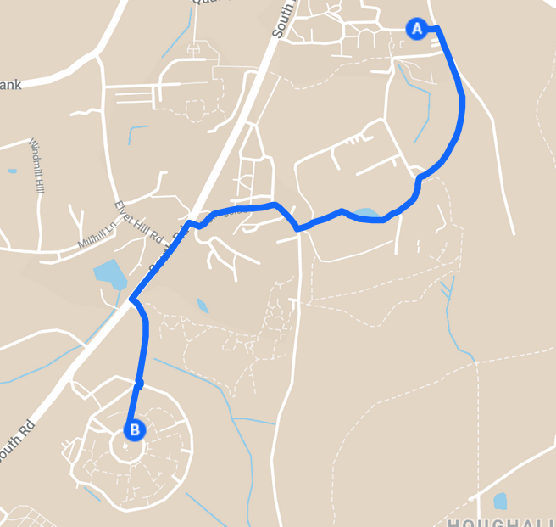
Range specification
Specification
Charge once per week
Days in use: 5 days (commute)
Distance each day: 3km
Estimated vertical distance: 80m
Range on full charge: ~15km
Estimated energy per mile: 10Wh/mile
Min capacity requirement: ~180Wh
Google maps example commute
Notes:
One of the key features of any electric vehicle is its range.
A vehicle is useless if it runs out of charge before you get anywhere.
The limiting factor on the range is the battery capacity
Since we want our skateboard to be commute ready, we designed it to only be charged once a week.
The range we picked was based on commuting around Durham, a reasonably hilly city.
The hills use a lot of energy to get up – so our energy capacity per mile will be much higher than what we would get on the flat.
To get a rough estimate we found some values for energy per mile usage for electric bikes and other skateboards.
We took an example commute, and used these to get a minimum capacity for our batteries
Key feature range
Useless without charge
Commute ready
Hills
Rough estimates
Example comutes

Slide 30
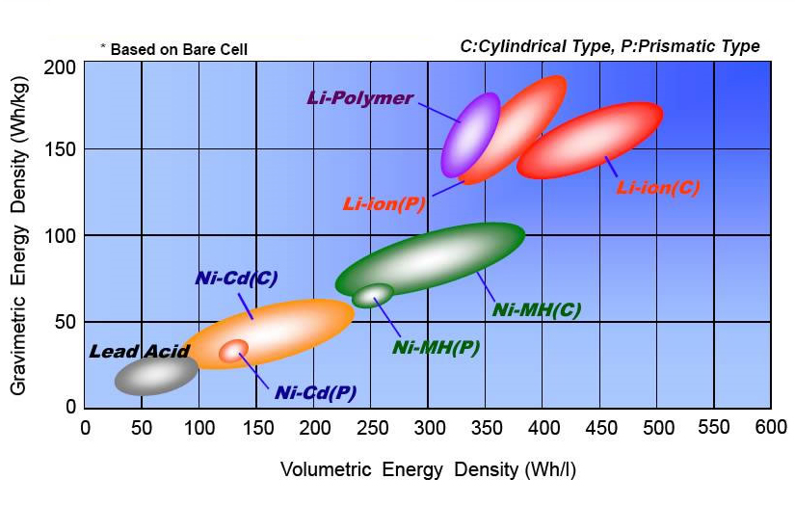
Battery specification
Lithium polymer chemistry
Watt-hour capacity: 180Wh
Supply voltage:22.2V
Amp-hour capacity: 8100mAh
Mass: 1.24kg
Supply voltage: 50v
2 batteries in series required
Figure from Comparison of Energy Density in Battery Cells - NASA
Notes:
The battery chemistry we chose was Lithium polymer.
Lithium polymer is one the most common type of battery used in portable electronics ranging from smartphones to higher power devices.
You can see that lithium polymer batteries have a very high energy density per unit mass – making it ideal for our lightweight skateboard design.
Lithium ion batteries on the other hand tend to have worse lifespan, and are heavier – but are a little cheaper.
In the end the weight savings of LiPos are worth the cost.
The battery we chose has a capacity of 180 watt hour, and a voltage of 22.2v.
Since our supply rail needs to be 40-50volts we need two of these battereies in series to bring the voltage up.
Since we have two of these the weight going to be non insignifigant – about 2.4kg total.
Lipo battery
Common for portable electronics
High energy density – better current then lion
Weight savings
Capacity 180Wh

Slide 31
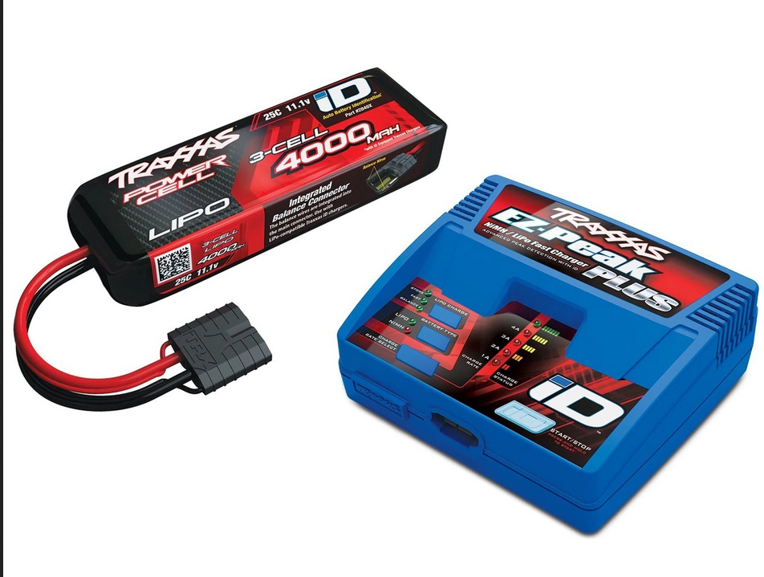
Battery charging
Lithium polymer can be dangerous:
Overcharging
Unbalanced charging
Use an off the shelf solution
Use hobby/RC charger
Charge batteries in parallel
System to switch between series and parallel
https://traxxas.com/products/parts/2994
Notes:
One of the downsides of lithium polymer is that it is extremely dangerous.
Lithium is very reactive, and these batteries can heat up or ignite if mistreated
To mitigate these risks we are using an off the shelf charger that is proven safe.
The charger we are using will balance the cell charges on the fly so no cell degrades faster than the others
Hobby chargers can’t handle 50v
This does mean we will have to switch between a series and parralel battery configuration for charging and use

Slide 32
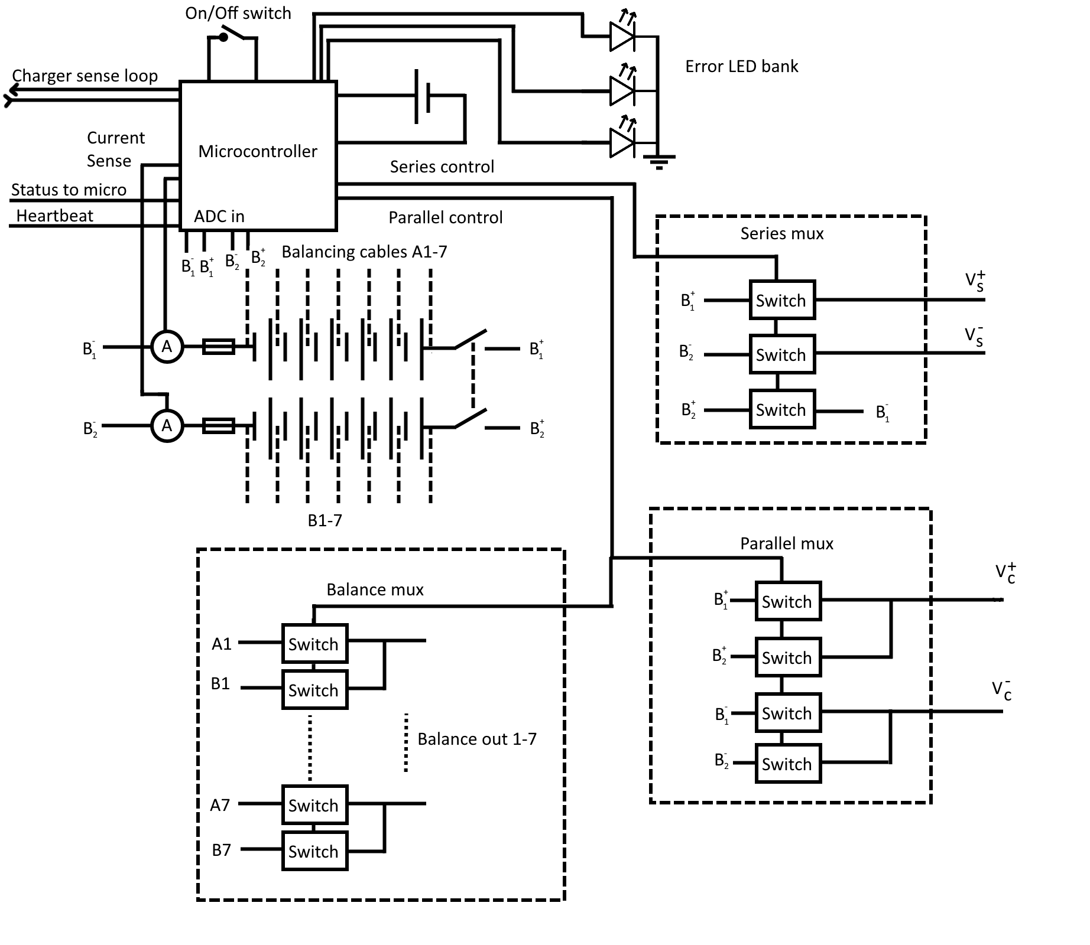
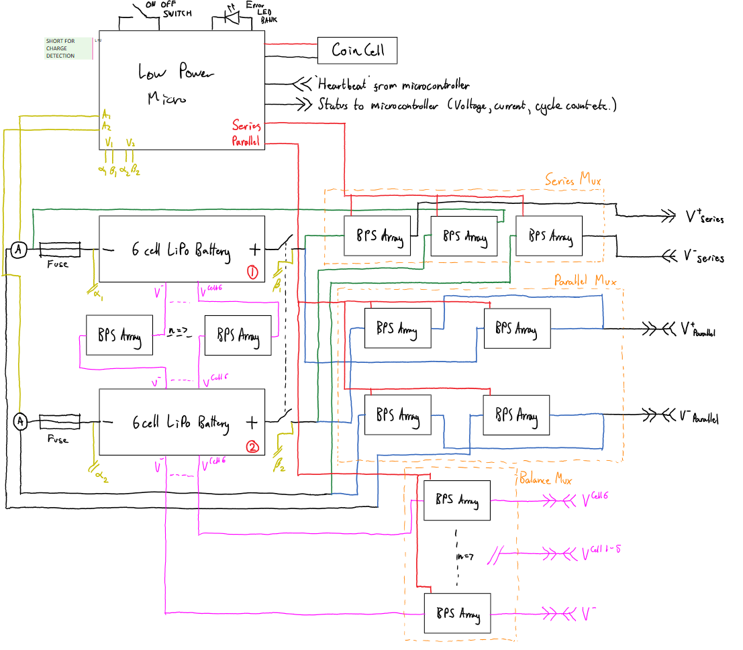
Battery control overview
Battery series/parallel multiplexer
Microcontroller
Independent power supply
Current monitors
Isolation switches
Fuses
Communication bus
Notes:
Battery control circuit
Independent power supply for the micro
Fuses stop the batteries destroying themselves
Mechanical isolation incase of down stream shorts
Finally we have the communication bus to the other micro so that if any errors occur we can react

Slide 33
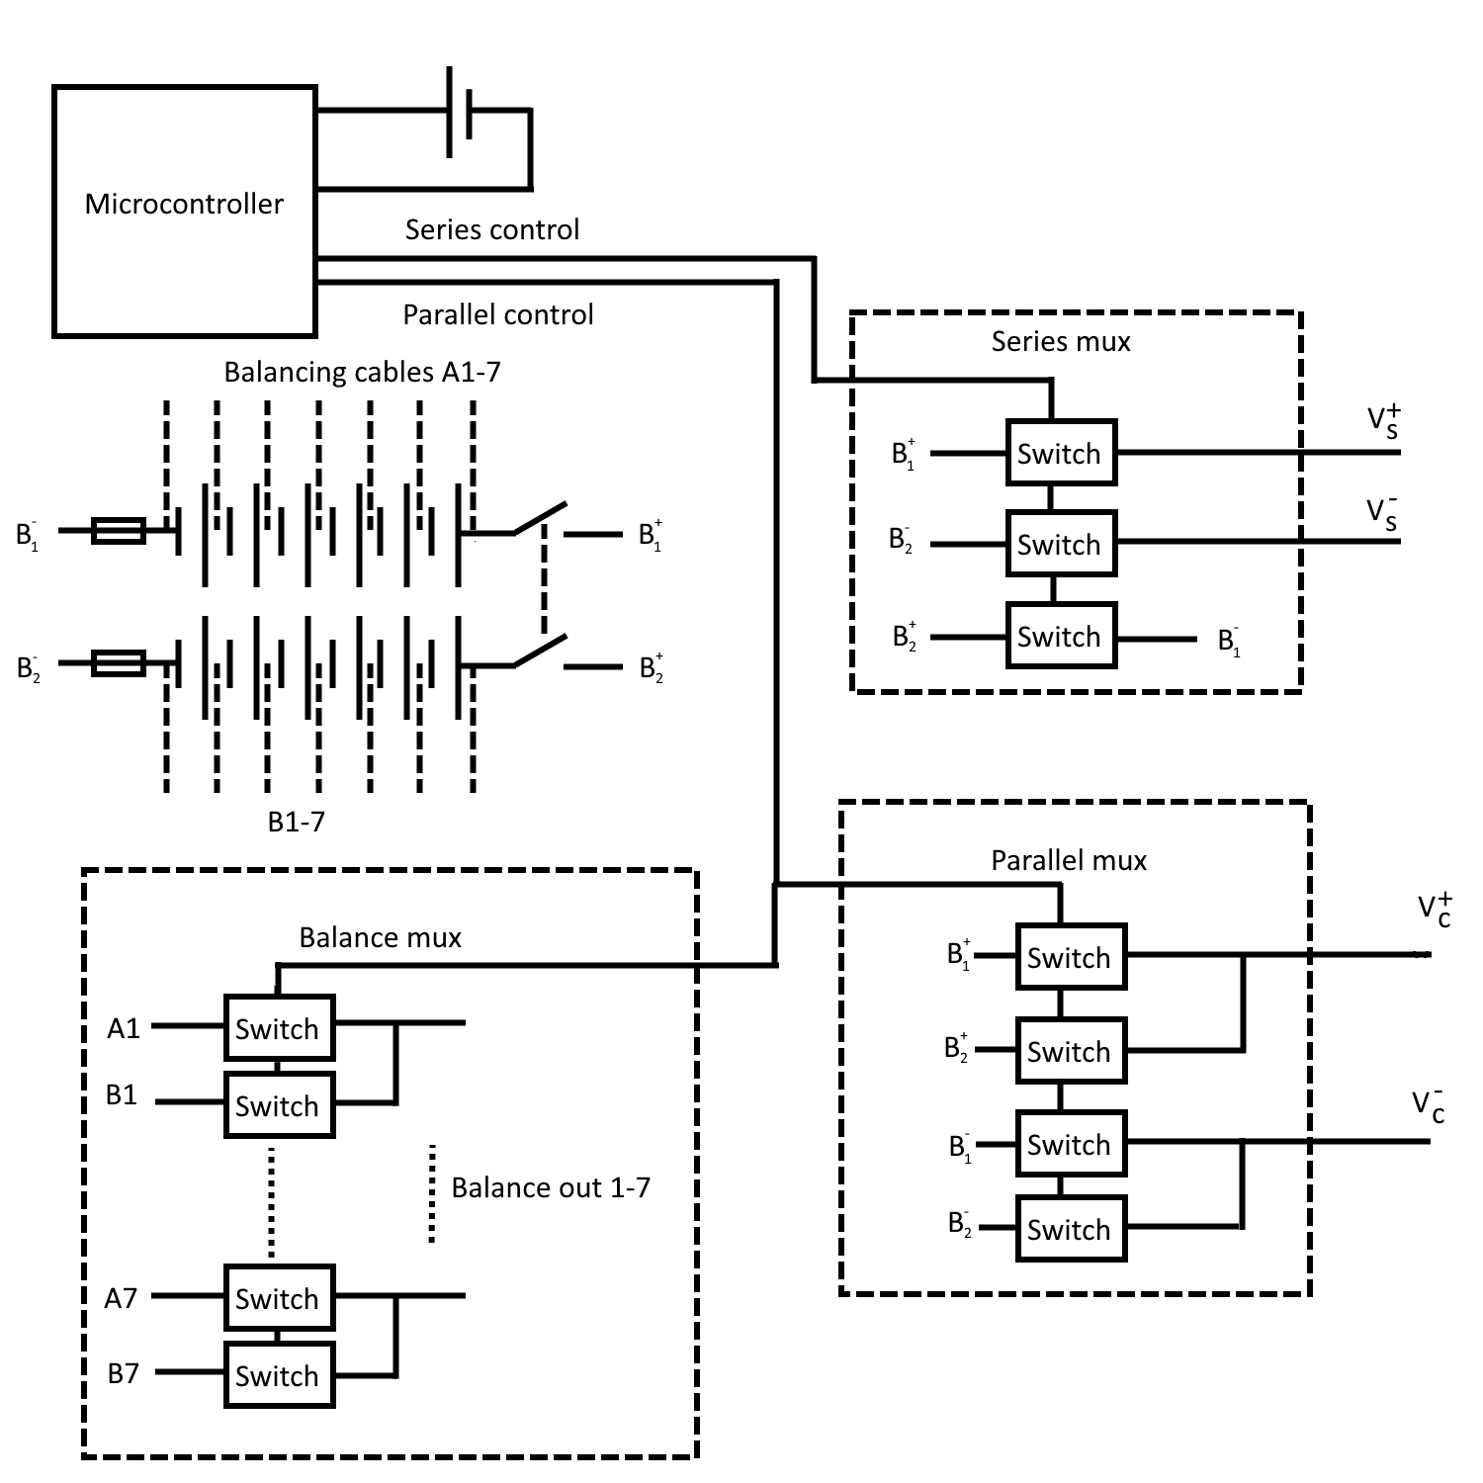
Battery multiplexer (mux)
Two large batteries
States:
Charge in parallel
Discharge in series
Disconnected
Electrically controlled path switching
Vibration resistant
Short resistant
Bidirectional current flow (balanced charging)
Notes:
Multiplexer has 3 states
Charge in parallel
Discharge
Disconnected – there are no live terminels out of the battery system

Slide 34
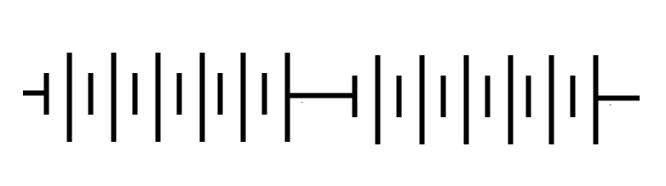
Multiplexer (cont)
Discharge
Equivalent circuit
Notes:
This section of the mux will handle the discharge path, which is 50V 200A rated

Slide 35
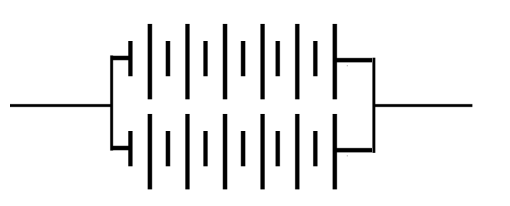
Multiplexer (cont)
Charge
Equivalent circuit
Notes:
This part of the mux will handle 25 volts, 10 amps rated

Slide 36
Multiplexer (cont)
Charging
Balance leads in parallel
Connects to charger
Notes:
Finally the balance mux will handle 7 smaller lower voltage low current paths for equalising the battery cells.
This current can be in either direction as some cells will be higher or lower charged.

Slide 37
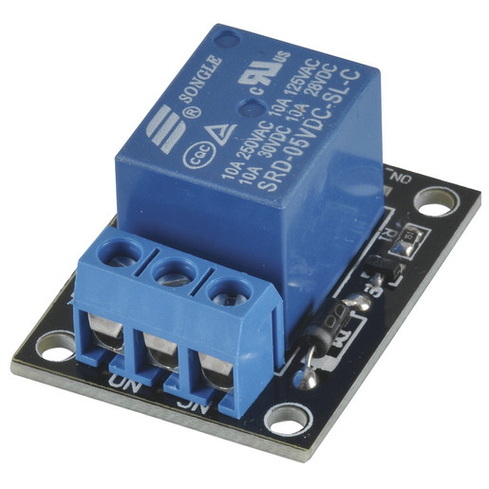
Switching technology
Relay:
Electro-Mechanical switch
Very high voltage
Very high current
Low standby draw
MOSFET power switch:
Solid state system
Low current
Higher power dissipation
Extra drive circuitry
Stock images from Farnell
Notes:
Relay
High V, high I, low standby draw – obvious choice
Easy circuitiry
Not resistant to vibrations – could cause a short + contact weld
Solid state:
Worse in most regards – but is resistant the mechanical issues

Slide 38
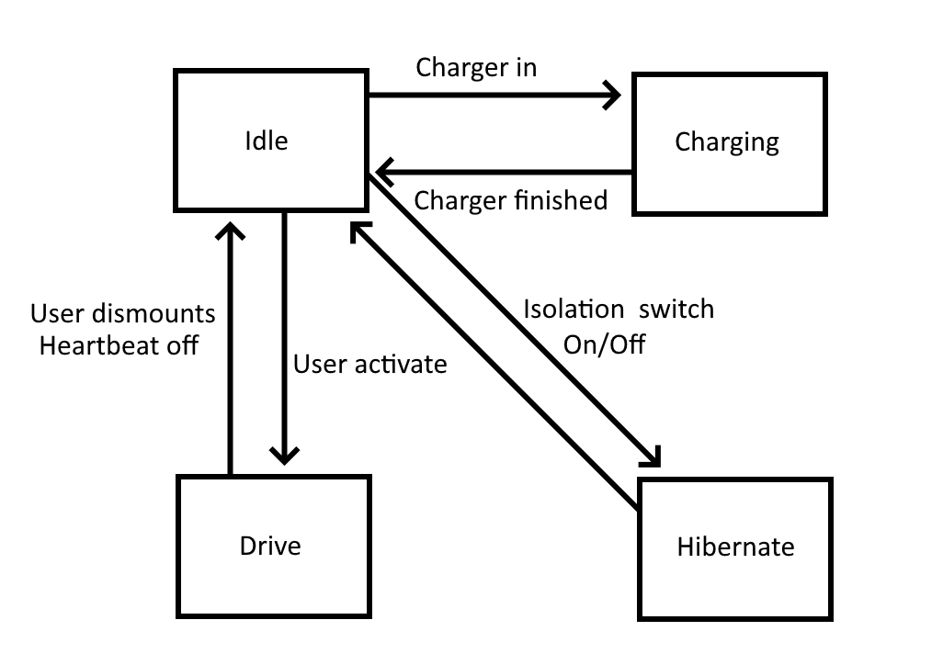

Battery embedded controller
STM8L – microcontroller
Ultra low power 10 $μA$ sleep state
Separate battery supply
Monitors battery health
Volts
Time
Cycle count
Controls battery mux
Heartbeat signal from main micro
Notes:
Since we have our eletriconally controlled switches – we are going to need something to control them.
For this job we are going to use a low power microcontroller.
This micro will stay on permenetntly and control the battery supply to the main circuit.
Since we are on a separate power supply we want to be as low power as possible – the micro we picked has a sleep state of 10 micro amps and uses about 100 micro ampls when operating.
going to have to live for the whole lifespan – no recharge
The micro will monitor the battery health, and can cut the power out if it thinks the battereies are damaged or degraded.
Finally the heartbeat signal is monitored by the micro – if it stopps we kill the 50v drive output to make the system safe and inert.
Kill the live 50v out – safe

Slide 39

Safety Measures
Conducted a Failure Mode Analysis
Determines edge cases which could lead to system damage/failure
Plans mitigation factors

Slide 40
Servicing
Lithium battery take back scheme & disposal
Replace main batteries and coin battery
Test and maintain circuitry
Check mechanical parts for damage
Replace consumable parts
Notes:
Due to the Li-Po's degrading they would need to be replaced every few years to keep the board now only functional, but also safe. This would be done with a servicing every three years, including replacing all the batteries, ensuring all of the electronics and mechanical parts are still functional and safe. This would be a service we would provide as Li-Po batteries are dangerous and need to be handled and disposed of correctly. This and with a 50v rail, it would be irresponsible to make the customers handle high voltages

Slide 41

End of Life
Lithium Polymers
EEE Waste
Readily removeable
Labelled fully
ABS plastic and wood are easily recyclable
Metal can be scrapped
Required Battery Symbol
Image from GOV.uk
Notes:
There are government regulations about the disposal of most batteries including li-po's. As this is a one off product, with only a few kilograms of batteries being used the law is relaxed as in this case the Li-Po cells must just be labelled properly and readily removable for safe disposal at a specialist place. We don't have to take it back since there are less than 32kg put on the market in a year. If this were to be scaled up, with many more made we would need to provide a 'take back scheme' to safely take these off the consumers hands and into that of a specialist disposer, as well as finance the disposal

Slide 42
Costing
Cost (£) | Item
£50.00 | Front and Rear Trucks (Torque Motors)
£72.00 | Motor Mount (Torque Motors 'V6')
£7.74 | Rubber Driven Wheels (x2)
£12.98 | Titanium Bearings (x4)
£0.19 | Weicon GMK 2410 Rubber Metal Contact Adhesive
£184.00 | 6374 DC Brushless Motors (x2)
£20.60 | 36 Tooth HTD5 Cog (36-5M-09F) (x2)
£5.98 | 12 Tooth HTD5 9mm Motor Cog (x2)
£21.48 | Belt HTD 300-5M-9 Continental (x2)
£126.00 | Li-Po Battery (x2)
£0.67 | Coin battery CR2032
£5.00 | Switch driver LTC7004
£38.00 | Battery charger
£13.50 | Power switches FDC6324L (x30)
£1.50 | Low power micro STM8L 152C6T6
£30.00 | Box and Rail ABS cost
£220.00 | ESC (x2)
£70.00 | Miscellaneous Parts
£879.64
Material Costs: £880
Boosted Boards 'Boosted Plus'
Retail Price: £1300
OneWheel's 'XR'
Retail Price: £1400
Notes:
A total cost for the bill of materials is £880. While this may seem steep, the material costs are a fraction of the retail price of other boards, meaning that once manufacturing costs are taken into account there is room for a decent profit, if the retail price were to is a comparable price to other commercially available boards of similar performance

Slide 43
Questions

